Slide 1
Git Essentials

Slide 2
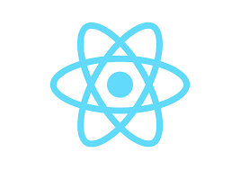


Deploy Applications – GIT & GitHub
GitHub → Web based code-hosting platform used for code collaboration and version control.
GitHub is a remote repository for your codebase, where multiple people can work on the same code simultaneously.
GIT → Distributed version control system designed to track the changes in project files .
GIT is the heart of GitHub and is responsible for everything GitHub-related that happens locally on your computer.
Most Commonly used GIT commands :
GIT clone → clones or duplicates the repository into local
GIT commit → The git commit command will save all staged changes, along with a brief description from the user, in a “commit” to the local repository.
GIT checkout → The git checkout command is a way of switching between branches or version of your application
GIT Push and GIT Pull → will send changes in local to the repo and will accept incoming changes from repo to local

Slide 3
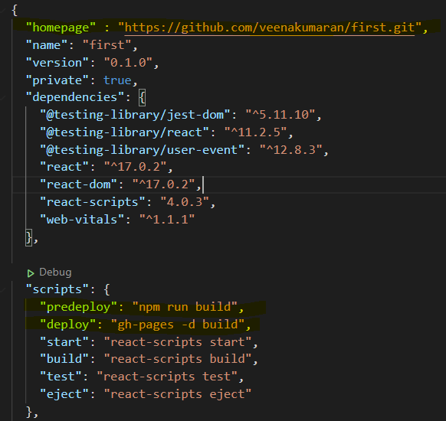
Deploy Applications – GIT & GitHub : ghpages
STEP 1 : Create A GitHub Account
STEP 2 : Install Git in your machine and Set up Git.
STEP 3 : Install GitHub pages package as dev-dependency
STEP 4 : Add properties to package.json file
“homepage” : “repo link to your project”
"predeploy": "npm run build", "deploy": "gh-pages -d build"
> npm install gh-pages --save-dev

Slide 4
Deploy Applications – GIT & GitHub : ghpages
STEP 5 : Create a new repo in GitHub and Initialize Git
STEP 6 : Deploy to GitHub pages
> git init
> git remote add origin “GitHub repo link”
> npm run deploy

Slide 5
Deploy Applications – GIT & GitHub : git
STEP 1 : Create A GitHub Account
STEP 2 : Install Git in your machine and Set up Git.
> git init
> git remote add origin “GitHub repo link”
> git add .
> git commit –m “first commit”
> git push origin master

